Slide 1
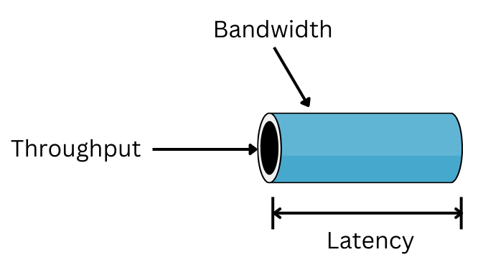

Slide 2
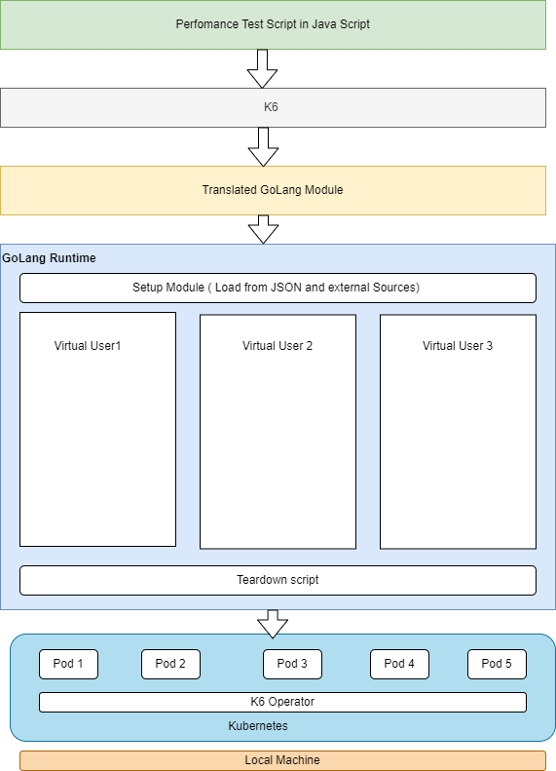
K6 Architecture and Flow
K6 is written in the goja programming language, which is an implementation of ES2015(ES6) JavaScript on pure Golang language.It doesn’t require nodejs
Goja is an implementation of ECMAScript 5.1 in pure Go with emphasis on standard compliance and performance.
Highly Configurable by design since it is script driven and integrated with CI/CD pipelines. Nimble agile teams to perform performance testing.
Virtual users are to used to simulate traffic in testing environment. K6 internally uses gorouting to simulate virtual users. 1 Single instance can hundreds and thousand of users.
Supports distributed load generation using k6 operator. It can run on top of kubernetes as pods.

Slide 3
How to Run K6
K6 Life Cycle
Create a scaffold file.
K6 create
To run k6 script
k6 run
K6 run –vus 10 –duration 10s simple.js
// 1. init code
2
3export function setup() {
4 // 2. setup code
5} Executed initially once , to load test data from external sources
6
7export default function (data) {
8 // 3. VU code
9} Executed initially once , to load test data from external sources Ex
10
11export function teardown{
12 // 4. teardown code
13}

Slide 4
Simulation of Real time traffic
Simulation of real time production data using shared array, faker library.
Simulation of real time execution through the concept of executors.

Slide 5
Simulation of Real time data
Use of faker library for data parameterization.
Connect to external source such as DB, JSON file and create a shared array across virtual users.
Shared Array Constraints - Wou
var data = new SharedArray("colors", function() {
return JSON.parse(open('./customers.json')).customers;
})
Iterations completed: ${exec.instance.iterationsCompleted}
K6 run dp.js

Slide 6
Simulation of Real time Traffic
Simulation of real time traffic by controlling the number of virtual users and iterations.
Configurable via JSON object with executor type, iterations count and count of virtual users.
K6 run executor.js

